Slide 1

SOIL DETECTION & BEST CROP PREDICTION
Presented by:
J.Suvarchala
A.Akshitha
A.Sanjana
G.Harshitha
SK.Juveria
GUIDED BY :
Dr.B.Suvarnamukhi
(Associate Professor)

Slide 2
Introduction
• Problem:
Traditional farming relies heavily on guesswork or delayed lab testing for soil quality, leading to lower yields and improper crop selection.
• Solution:
An interactive, user-friendly website that analyzes soil parameters and recommends the most profitable or suitable crops.
Target:
Small-scale farmers, agricultural students, and local researchers.

Slide 3
Objectiveof the Project
• Build a responsive web interface for easy data input and result visualization.
• Accept soil test metrics (pH, Nitrogen, Phosphorus, Potassium, Moisture, Temperature).
• Deploy a machine learning model to predict the ideal crop.
• Provide actionable fertilizer or care recommendations alongside the crop suggestion

Slide 4
System Architecture
• Frontend:
HTML, CSS, JavaScript (or React / Bootstrap) for the user dashboard.
• Backend:
Python (Flask / Django) to handle requests and run business logic.
• Database:
MySQL / MongoDB for storing user inputs, historical queries, and crop datasets.

Slide 5
Key Parameters Used for Detection
• Soil Nutrients:
• Nitrogen (N)
• Phosphorus (P)
• Potassium (K)
• Soil Condition:
pH level, Moisture content.
• Environment :
Temperature, Humidity, and Rainfall.

Slide 6
Machine Learning Pipeline
Data Collection:
Sourced from agricultural datasets.
Data processing:
Handling missing values, feature scaling, and train-test splitting .
Model Selection:
Comparing algorithms like Random Forest, Decision Tree, K-Nearest Neighbors (KNN), and Logistic Regression.
Evaluation:
Comparing models based on accuracy, precision

Slide 7
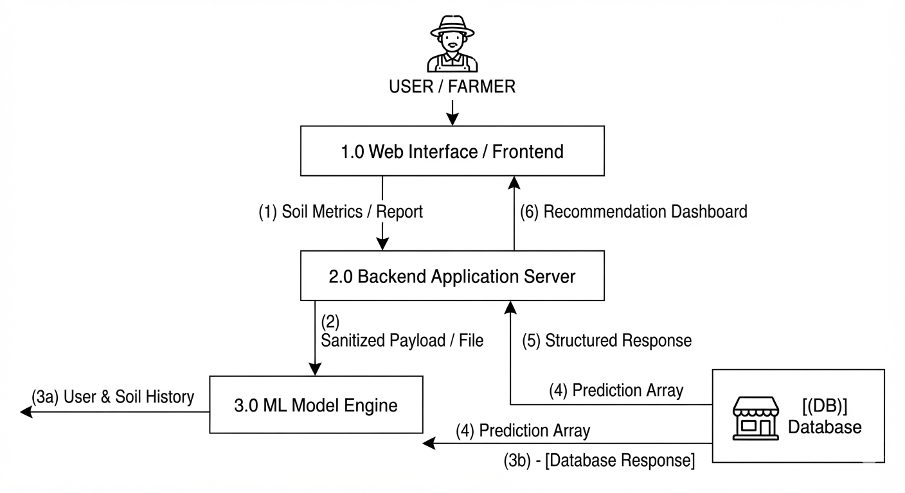
Data Flow Diagram

Slide 8
Advantages & Impact
• Data-Driven Decisions:
Replaces trial-and-error with scientific prediction.
• Resource Optimization:
Reduces overuse of chemical fertilizers and water.
• Accessibility:
Simple web portal accessible via desktop or mobile browser.

Slide 9
Limitations & Future Scope
• Limitations:
Dependent on the accuracy of user-inputted soil test values.
• Future Scope:
• Integrating real-time IoT soil sensors for automated data streaming.
• Adding plant disease detection via leaf image upload (CNN).
• Multi-language support for regional farmers.

Slide 10
Conclusion
Soil Detection and Best Crop Prediction, acts as a vital bridge between modern technology and traditional agriculture by replacing guesswork with data-driven decision-making.
A successful demonstration of applying machine learning to solve real-world food security and farming challenges

Slide 11

Questions are Welcome

